Slide 1

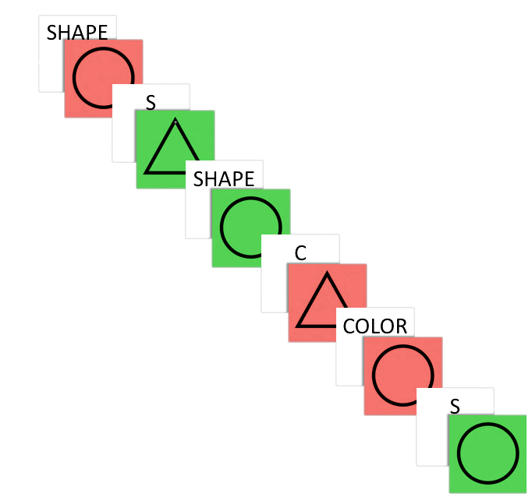
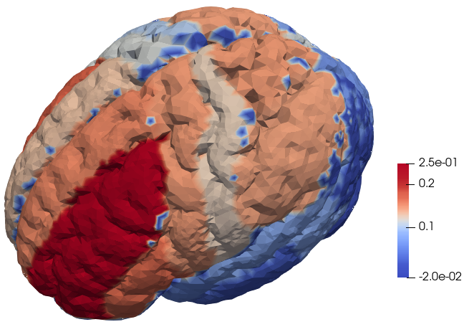
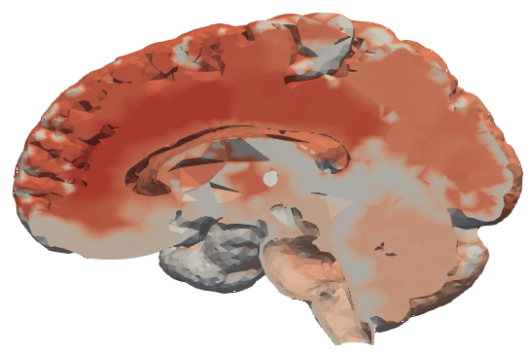
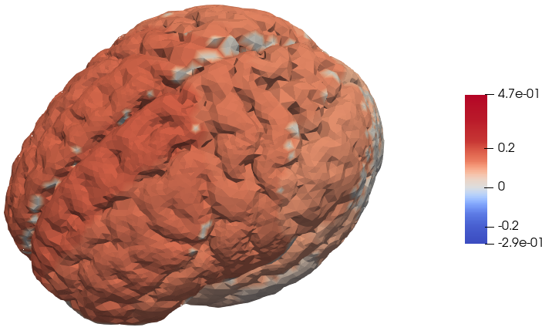
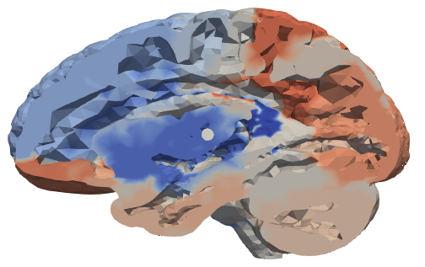
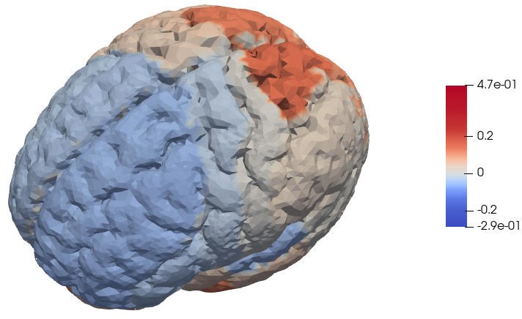
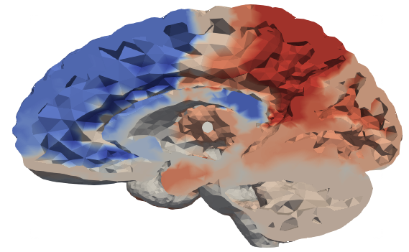
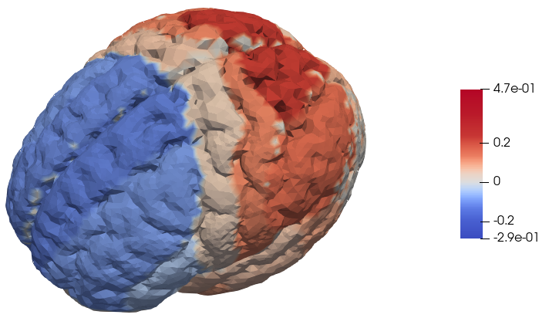

Case Study on Task-Switching in Schizophrenia: brain activity and compensation mechanisms
Costanza Cantalini, Erica Bistacchia, Lorenzo Ferrara and Scott Pesenti Tutors: Prof. Laura Maria Sangalli, Dr. Eleonora Arnone Ph.D, Dr. Letizia Clementi
INTRODUCTION
One of the regions hindered by schizophrenia is the dorsolateral prefrontal cortex (DLPFC) which has been associated to the ability of task switching (TS). Nevertheless, literature suggests that people affected by schizophrenia (SCHZ) do not perform worse than a neuro-typical control population (CTRL). Apparently SCHZ are simply slower in TS but reach the same tasks’ performances of CTRL. The literature assumes that this latter fact is possibly due to some unknown compensation mechanism in the SCHZ’s brain.
DESCRIPTION OF THE DATASET
175 participants (125 CTRL and 50 SCHZ).
For each participant:
Health-related data ➔ age and BMI
Functional connectivity map, a table of >36000 values, each corresponding to a node of the brain mesh on which the fMRI data was projected
Event recordings, a time step dataset composed of all the readings from the test, such as: reaction time, cue, answer.
CASE STUDY OVERVIEW
OBJECTIVES
According to the literature:
SCHZ are slower than CTRL but have comparable performance in the task-switching test;
brain activity between SCHZ and CTRL differ in specific regions’ activity.
Our objective was to verify or reject these hypotheses.
CSI
TASK-SWITCHING
While under fMRI each participant was presented with a series of geometric shapes and asked to identify either the color or the shape of the image based on the task cue presented prior to the image.
On 25% of trials the instructions switched, i.e., participants were instructed to switch from identifying shape to identifying color, or vice versa.
Sometimes there was congruency, i.e., when the wrong rule incidentally produces the same target answer.
The Event Recordings dataset was gathered during this experiment.
Incongruent
Task switch
Incongruent &
switching
DORSOLATERAL PREFRONTAL CORTEX
Instructions
Red or Circle = Right button
Green or Triangle = Left button
Fig. 1 Sample of task switching experiment
Fig. 2 Region of interest
REACTION TIME
Reaction time is the interval elapsing between a cue and the participant’s response.
Normality: Shapiro test
p-value = 0.016 (CTRL), p-value = 0.09 (SCHZ)
T-test on the means of the Reaction Times: CTRL vs SCH
p-value ≈ 0
Confidence interval for the difference of the means:
[0.173, 0.232, 0.292]
We can confirm that SCHZ are indeed slower than CTRL: this is consistent with the literature.
EXPLORATORY ANALYSIS
CONFOUNDING FACTORS
Reaction Time ~ Age + BMI + Diagnosis + Age : Diagnosis + BMI : Diagnosis
PSYCHOLOGICAL TRAITS: BARRATT IMPULSIVENESS SCORES
Impulsivity is the predisposition toward rapid unplanned reactions.
T-test on the Scores of the Barratt Impulsivity Test (BIS) :
SCHZ scores vs CTRL scores
p-value ≈ 1
Reaction Time ~ BIS
The BIS did not turn out
to be a statistically
significant regressor.
No interaction appeared significant
Both Age and BMI have an increasing effect on reaction times.
However, we will not consider these factors in the ANOVA as we do not have enough observations - also these factors are not controllable.
Fig. 3 Box Plot of the Reaction Times for SCHZ and CTRL
Fig. 5 Linear Regression Reaction time vs BIS
Fig. 4 Box Plot of the BIS for SCHZ and CTRL
Fig. 6 On the right: a) LRM Reaction time vs Age b) LRM reaction time vs log(BMI)
Above: c) LRM Reaction time vs Age + BMI
PERFORMANCE ANALYSIS
Performance is measured via:
Switch cost: $μ$_{Switch} – $μ$ _{noSwitch} = mean time during Switch trials - mean time during NoSwitch trials
Correct cost: $μ$_{Correct} - $μ$_{nonCorrect} = mean time during Correct trials - mean time during NoCorrect trials
General accuracy rate: #correct_trials / #total_trials
Switch accuracy rate: 1 - #errors_on_Switch / #total_errors
Analysis:
Switch Costs and Correct Costs;
ANOVA;
analysis of error/accuracy rates.
RESULTS
PRINCIPAL COMPONENT ANALYSIS
p>n: Aggregated the nodes into the 83 Hammers canonical regions
ANOVA
Reaction Time ~ diagnosis + congruent + switch + diagnosis *congruent + diagnosis *switch +
+ congruent*switch
It showed:
high significance of diagnosis and switch;
no statistically significant interaction.
Stepwise reduction:
Reaction Time ~ diagnosis + switch
1st PC - Weighted average of overall brain activation levels.
Emphasis on regions specifically involved in learning, action, and prediction.
Cingulate gyrus involved in prediction.
Caudate nucleus regulates execution of movement and learning.
Putamen manages general cognitive functioning.
Superior frontal gyrus is key in maintaining working memory.
We can state that the difference between Switch Costs for SCHZ and CTRL are not statistically significant, i.e., switching seems not to hinder SCHZ’s reaction time more than CTRL.
Fig. 9 Box Plot of ANOVA trials conditions
Fig. 9 Box Plot of ANOVA trials conditions
Fig. 12 a) Box plot of the scores on the first PC b) Projection of the first PC on the brain mesh
LINEAR MIXED MODEL
The previous ANOVA does not consider that times are not independent.
Subjects' grouping as a Random Intercept in a LMM
Reaction Time ~ diagnosis + switch + (1|Subject)
PVRE = 0.8483049
2nd PC - Prediction mechanism.
The brain makes a prediction about external reality from biological signals (sensorial and emotional), rewarding itself if the prediction is accurate. Opposite signs on the loadings highlight the delay between hand-eye coordination and the prediction.
This value is extremely high, suggesting that most of the real variability must be assigned to the intrinsic differences between participants rather than the difference between two groups.
Superior parietal gyrus, manage hand-eye coordination.
Cingulate gyrus reconstruct reality from biological inputs.
Nucleus accumbens regulates emotional response.
Subgenual frontal cortex and Subcallosal area are responsible for regulating the reward mechanism.
Fig. 7 a) Box Plot of Reaction Time in Switch and Non-Switch events b) Box Plot of Switch Cost
T-test on the mean of the Switch Cost (p-value = 0 .4643)
Fig. 10 From the top: a) Box Plot of the Random intercept values for SCHZ and CTRL b) Dotplot of the Random intercept values for SCHZ and CTRL
Fig. 13 a) Box plot of the scores on the second PC b) Projection of the second PC on the brain mesh
CONSIDERATIONS ABOUT ACCURACY
3rd PC - Regulation of dopamine release.
Lower scores in SCHZ show an unbalanced or ineffective production of dopamine (coherent with literature).
CTRL have higher accuracy
SCHZ accuracy rate is lower than the CTRL one
SCHZ accuracy on switch is higher than the-CTRL one
The previous results falsify what has been proposed in the literature.
It appears that no compensating mechanism is necessary as the accuracy rate of SCHZ is lower than CTRL but seems independent of task switching.
Nucleus accumbens stimulates motivation and action reinforcement. Lateral ventricle is mainly responsible for dopamine production. Substantia nigra coordinates motor planning and reward seeking. Subcallosal area.
Fig. 14 a) Box plot of the scores on the third PC b) Projection of the third PC on the brain mesh
Fig. 8 a) Box Plot of Reaction Times when participants answered correctly and not b) Box Plot of Correct Cost
T-test on the mean of the Correct cost (p-value = 0.5299)
Classification attempt
Through a MANOVA we ascertained that projecting all participants on the first three PCs would not be sufficient to build a classifier. Additionally, we observed that neurotypical people tend to be less homogeneous in brain activity, unlike what we saw in the analyses of performances.
Fig. 11 From the left: a) Box plot of General accuracy rates for CTRL and SCHZ
b) Box plot of Switch accuracy rates for CTRL and SCHZ
CONCLUSIONS
REFERENCES
SCHZ exhibit a higher reaction time and a lower accuracy rate than CTRL, but both results seem to be independent of task switching. We falsify the hypotheses under concern: SCHZ do not employ a compensatory mechanism in task-switching, rather displaying an insensitivity to task switching.
Their overall worse results are modulated by a comparable speed-accuracy trade-off with respect to CTRL. There is a general difficulty of
SCHZ to maintain and implement a task-set (perceptual, cognitive and response biases to optimize task performance).
Participants affected by schizophrenia retain less information and cognitive configuration across tasks (each trial
being independent of the previous one).
Our PCA shows no difference in brain activation between SCHZ and CTRL.
Differing cognitive functioning between the two groups (general slowing) is to be looked for in the complex interaction between brain networks rather than in the anomalous activation of just one or few selected regions.
Our LMM analysis indicates a high variability across participants.
Differing performances cannot be attributed to diagnosis alone.
[1] Susan M. Ravizza, Cameron S. Carter, Shifting set about task switching: Behavioral and neural evidence for distinct forms of cognitive flexibility, Neuropsychologia 46 (2008) 2924–2935
[2] Susan M. Ravizza, K.C. Keur Moua, Debra Long, Cameron S. Carter, The impact of context processing deficits on task-switching performance in schizophrenia, Schizophrenia Research 116 (2010) 274–279
[3] Alina Gomide Vasconcelos, Leandro Malloy-Diniz, Humberto Correa, SYSTEMATIC REVIEW OF PSYCHOMETRIC PROPRIETIES OF BARRATT IMPULSIVENESS SCALE VERSION 11 (BIS-11), Clinical Neuropsychiatry (2012) 9, 2, 61-74
[4] Nachshon Meiran, Joseph Levine, Naama Meiran and Avishai Henik, Task Set Switching in Schizophrenia, Neuropsychology 2000, Vol. 14, No. 3, 471-482
[5] Rotem Leshem, Relationships between trait impulsivity and cognitive control: the effect of attention switching on response inhibition and conflict resolution, Cogn Process (2016) 17:89–103
[6] Glenn R. Wylie, E. A. Clark, P. D. Butler and D. C. Javitt, Schizophrenia Patients Show Task Switching Deficits Consistent With N-Methyl-DAspartate System Dysfunction But Not Global Executive Deficits: Implications for Pathophysiology of Executive Dysfunction in Schizophrenia, Schizophrenia Bulletin vol. 36 no. 3 pp. 585–594, 2010
[7] Fred W. Sabb, Gerhard Hellemann, Nicholas B. Allen, Carrie E. Bearden, Enhanced switching and familial susceptibility for psychosis, Brain and Behavior. 2018;8:e00988
[8] S. Jamadar, P. Michie, F. Karayanidis, Compensatory mechanisms underlie intact task-switching performance in schizophrenia, Neuropsychologia 48 (2010) 1305–1323
[9] Dara S. Manoach, Kristen A. Lindgren, Mariya V. Cherkasova, Donald C. Goff, Elkan F. Halpern, James Intriligator, and Jason J.S. Barton, Schizophrenic Subjects Show Deficient Inhibition but Intact Task Switching on Saccadic Tasks, BIOL PSYCHIATRY 2002;51:816–826
[10] Paul D. Kieffaber, Emily S. Kappenman, Misty Bodkins, Anantha Shekhar, Brian F. O’Donnell, William P. Hetrick, Switch and maintenance of task set in schizophrenia, Schizophrenia Research 84 (2006) 345–358

